Slide 1
Low-Cost, Portable, Pneumonia Diagnostic Device
Sheun Aluko
Team Members: Lauren Bedell and Clark Ingram
Mentor: Dr. Dan Moran

Slide 2
Global Prevalence of Pneumonia
References:
World Health Organization. "Pneumonia." ; World Health Organization “The top 10 causes of death”; http://www.who.int/mediacentre/factsheets/fs310/en/index4.html
Notes:
WHO places LRTI’s as the 4th leading cause of death in the world in 2012, accounting for approximately 5.5% of annual global mortality
However in low-income level countries the world health organization reports that lower respiratory tract infections are the leading cause of death indicating there is still a significant need for improved methods of pneumonia diagnosis and treatment in developing countries

Slide 3
Need and Project Scope
Limited number of physicians
Limited number of technicians
Unreliable electricity
Low-Cost, Portable, Adult Pneumonia Diagnostic Device with high usability in Developing Countries
High cost of pre-existing devices
High prevalence of pneumonia
Notes:
A multitude of individuals needing prompt diagnosis and treatment
Limited number of technicians to operate available equipment
Limited number of trained medical staff to interpret images and chest sounds
Limited access to electricity for diagnostic equipment

Slide 4
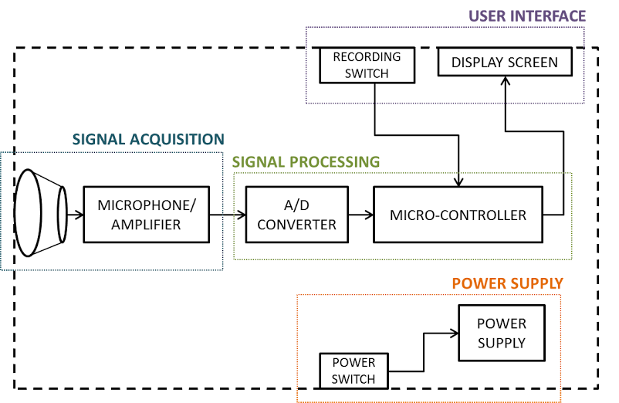
Overview of Device Modules

Slide 5
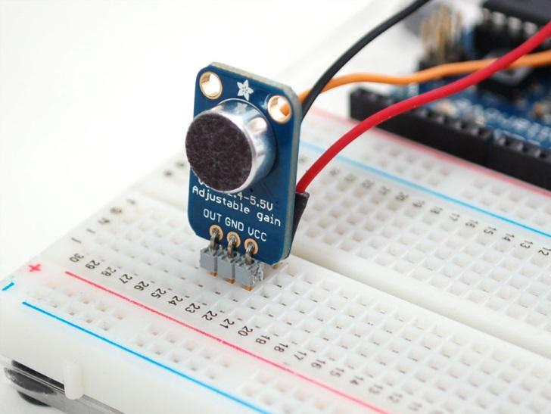
Signal Acquisition Module
Three main components
Diaphragm to pick up vibrations
Chamber to direct acoustic vibrations to microphone
Microphone for signal transduction
Littman: 36556 Tunable Diaphragm and Rim Assembly
Adafruit Electret Microphone Amplifier-MAX4466 with Adjustable Gain

Slide 6
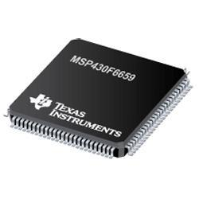
Signal Processing Module
Analog to digital convertor for input signal
Microprocessor for pneumonia classification
Specification | Value
Length of Audio Sample | 15 seconds
Sampling Rate (Samples/s) | 8,000 Hz
Sample Bit Resolution (Bits/s) | 10 bits
Memory Type | Size | Quantity
Buffer (for calculations) | 146.5 KB | 2
Buffer (for stored values) | 1 byte | 5
Data Storage (for processed signal) | 146.5 KB | 1
TOTAL MEMORY NEEDED | 439.505 KB | NA
ADC Bit Size | 10
ADC Sampling Speed | 8,000 Hz
Microcontroller Memory | > 440 KB
Microcontroller Analog Inputs | 1
Microcontroller Digital Inputs | 1
Microcontroller Digital Outputs | 8

Slide 7
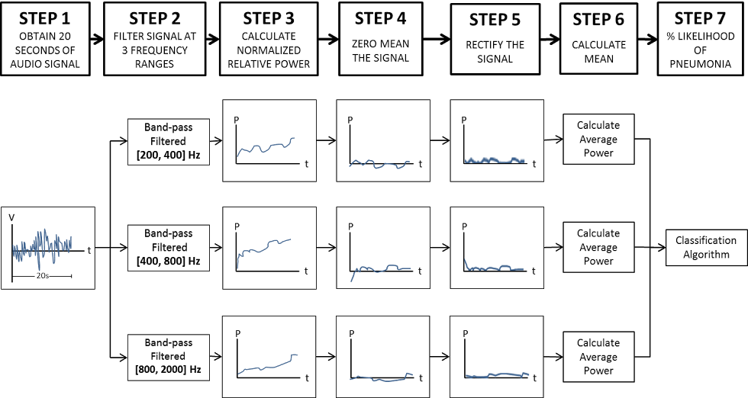
Software Process
Notes:
LF wheezes, coarse crackles
HF wheezes, fine crackles
High frequency noise due to airflow turbulence

Slide 8
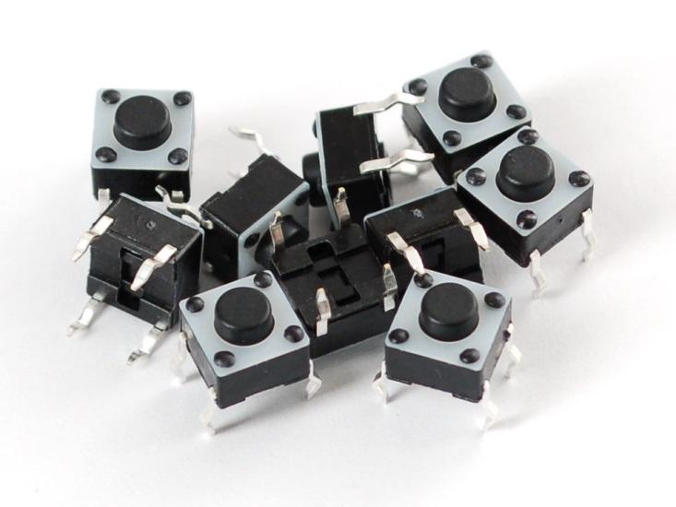
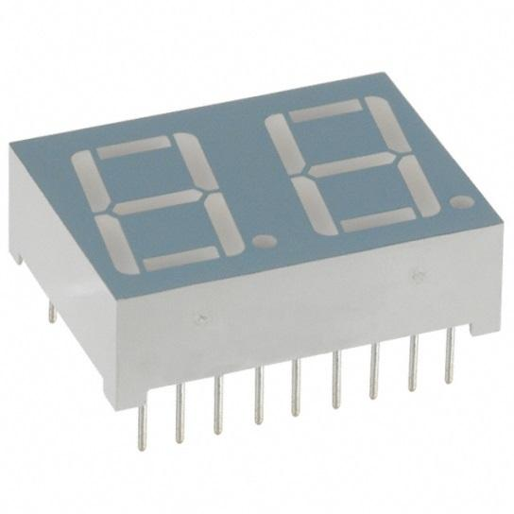
User Interface Module
Two main components
Switch to initiate recording
Display for pneumonia classification results
Adafruit Tactile Button Switch
LUMEX 0.5in 2-Digit 7-Segment Display

Slide 9
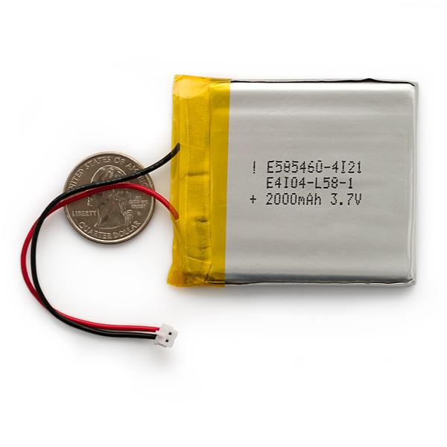
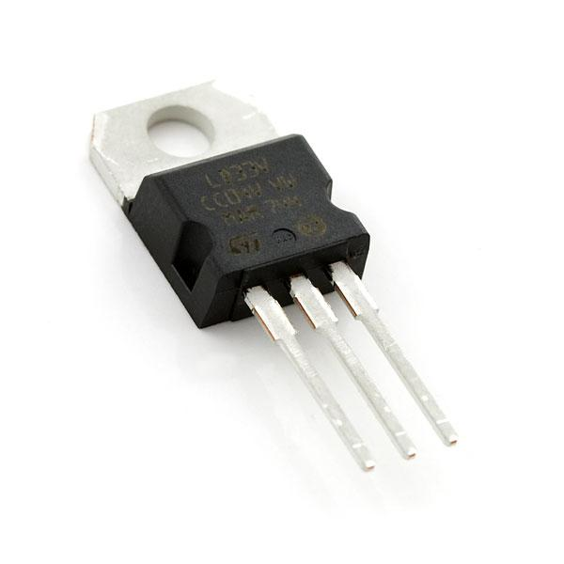
Power Module
Two main components
Battery to power device electronics
Regulated voltage supply
Part | Current | Power
MSP430 (micro-controller) | 0.6 mA | 1.8mW
microphone | 0.5 mA | 1.5mW
amplifier | 24 uA | 0.072mW
Dual LED | ~ | 105 mW
LED driver (2) | ~ | 1000 mW
Total | ~ | 1.108 W
Sparkfun Low Drop Fixed and Adjustable Positive Voltage Regulator
Sparkfun Polymer Lithium Ion Battery

Slide 10
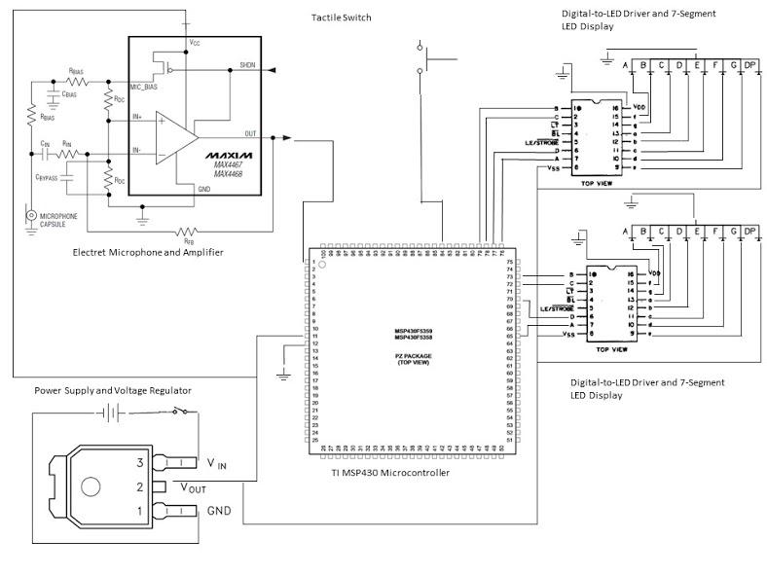
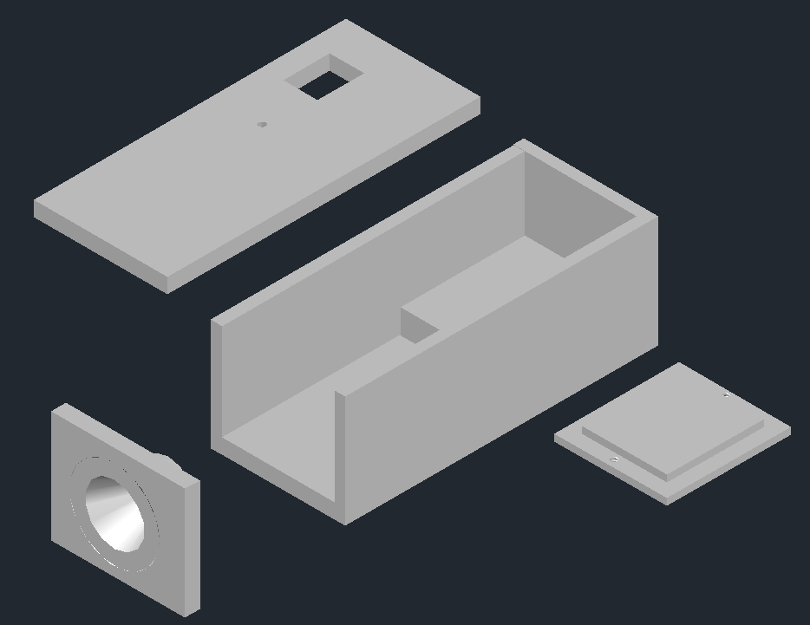
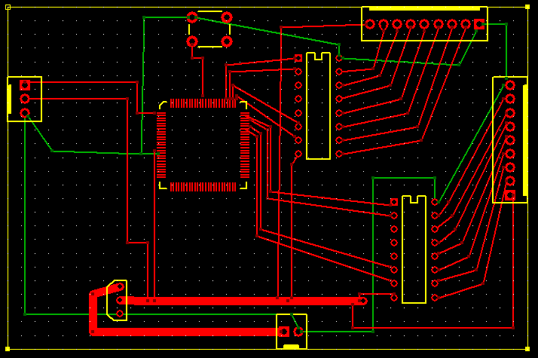
Device Connectivity

Slide 11
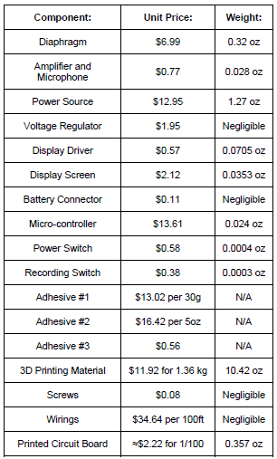
Parts, Manufacturing, and Assembly
<$150 and <0.5 kg
Notes:
Obtaining -> majority can be shipped with standard ground sipping with minimal lead times
Assembly -> Use of industrial adhesives and soldering
Take away ? <$150 and <0.5 kg

Slide 12
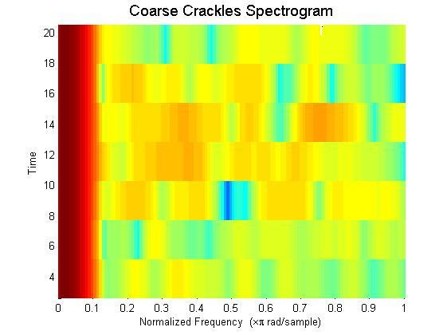
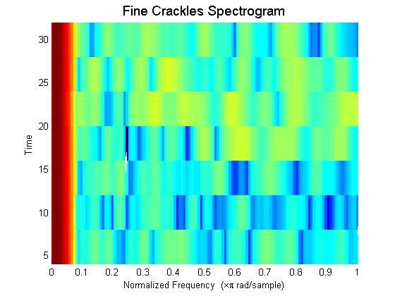
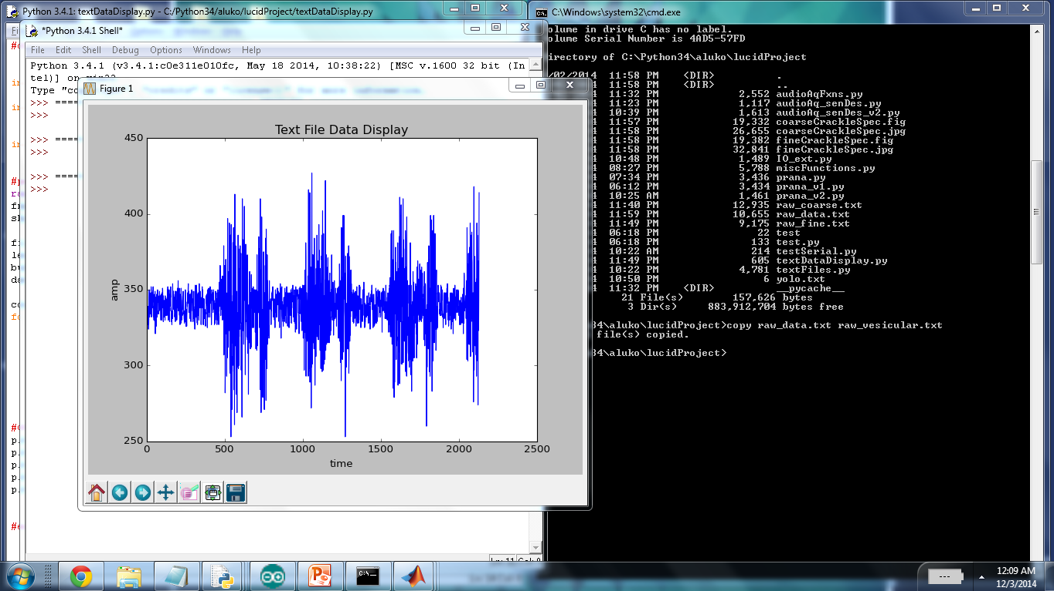
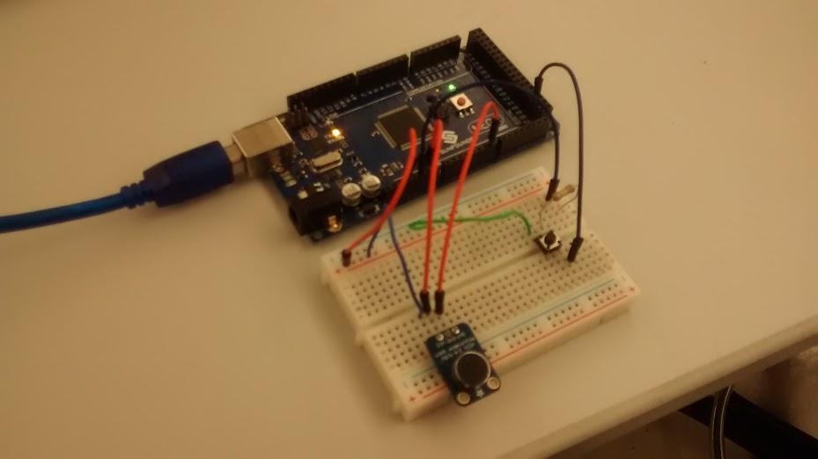
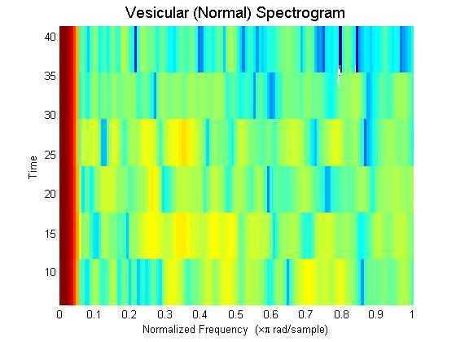
Proof of Concept / Prototype

Slide 13
Conclusions
Was the problem resolved?
LDA classifier training
Regulatory approval
Future Directions?
Clinical trial
Improved device components and assembly
ADC, microphone, DSP
IP
Device components licensed
Software algorithm and application of licensed devices may be patentable
Completely functional prototype yet to be made
What did we learn?
Foresight and planning crucial
Co-dependency of device components
Engineering design is not an individual process
Diversity of skillsets
Division of work
Time management

Slide 14
Acknowledgements
Team Members:
Lauren Bedell
Clark Ingram
Mentor: Dr. Dan Moran
Professor: Dr. Joseph Klaesner
TA: Rebecca Gilson

Slide 15
Questions?

Slide 16
PCB Schematic

Slide 17
Assembled Device Enclosure

Slide 18
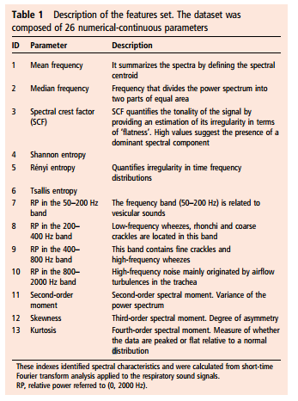
Frequency Band Information

Slide 19
Pneumonia Detection

Slide 20
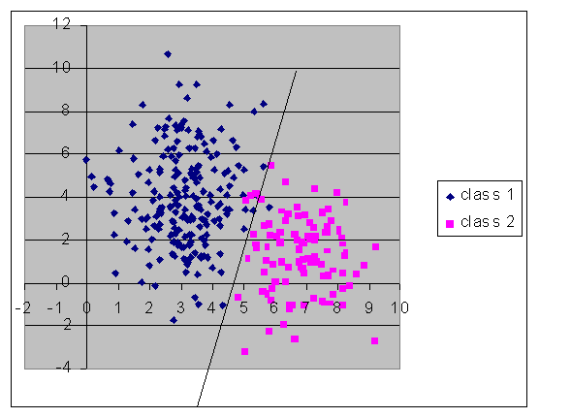
LDA Visualization

Slide 21
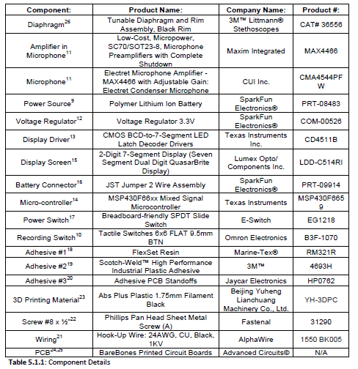
Parts

